Slide 1

Basics of Neural Network Programming
Computation Graph
deeplearning.ai
Notes:
<number>

Slide 2
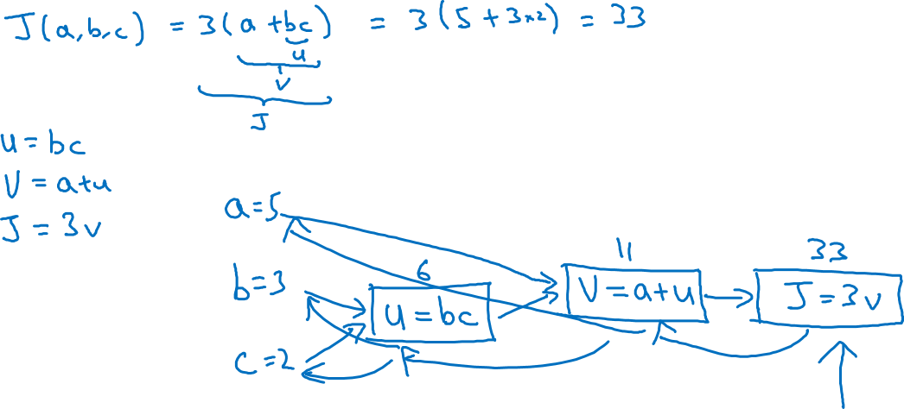
Computation Graph

Slide 3
Basics of Neural Network Programming
Derivatives with a Computation Graph
deeplearning.ai
Notes:
<number>

Slide 4
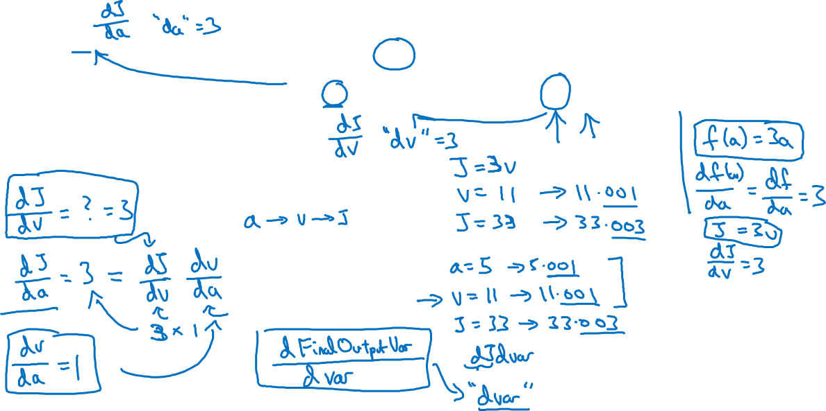



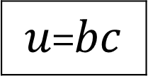
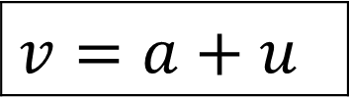

Computing derivatives
$a=5$
11
33
$b=3$
6
=
$c=2$

Slide 5
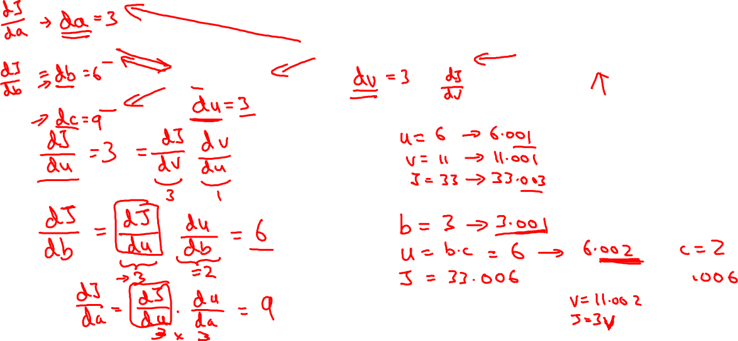
Computing derivatives
$a=5$
11
33
$b=3$
6
=
$c=2$

